Slide 1
Amazon Web Services : Security Cloud
Chinmay Oak : 16010122126
Nilesh Pany :S 16010122130 Batch: A4 Faculty Name: Prof. Zaheed Shaikh

Slide 2

Introduction to AWS Security
Amazon Web Services (AWS) is a leading cloud computing platform offering scalable, on-demand resources and services. Security is a core element of AWS, designed with a shared responsibility model: AWS manages the security of the cloud infrastructure, while customers are responsible for security in the cloud (e.g., data encryption, access management).
AWS provides extensive tools and frameworks to support confidentiality, integrity, and availability of data. These include Identity and Access Management (IAM), encryption services, security monitoring, compliance certifications, and more.

Slide 3
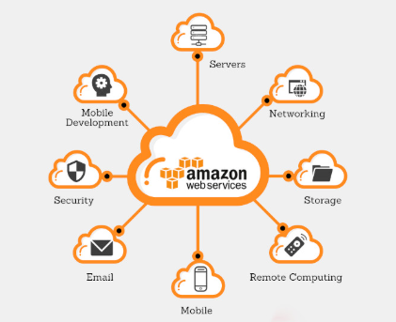
Aws Security
AWS Security is a set of tools and practices provided by Amazon Web Services to protect your data, applications, and infrastructure in the cloud. It follows a shared responsibility model, where AWS secures the cloud infrastructure, and you secure what you put in the cloud (like data, permissions, and configurations). Key features include:
IAM for access control
VPC & firewalls for network security
Encryption for data protection
Monitoring tools like CloudTrail and GuardDuty
Compliance support for industry standards
It ensures your cloud environment is safe, reliable, and compliant.

Slide 4
Motivation for the Research
As cloud adoption continues to grow, security becomes a top concern for organizations moving sensitive data and operations to platforms like Amazon Web Services (AWS). Traditional security models often struggle to keep up with the dynamic, scalable, and distributed nature of cloud environments.
This research is motivated by the need to:
Understand and address security challenges unique to AWS environments, such as misconfigured services, unauthorized access, and data breaches.
Explore how graph analysis can enhance AWS security, by modeling relationships between users, services, and data to detect threats and optimize access control.
Support businesses in achieving secure, compliant, and resilient cloud deployments by leveraging AWS’s built-in tools effectively.
Bridge the gap between complex cloud infrastructure and intelligent security solutions through analytical methods.
In short, the goal is to improve cloud security awareness and capabilities using a modern, analytical approach tailored for AWS.

Slide 5
Research Objectives
Identify Key Security Challenges in AWS Investigate common vulnerabilities, such as misconfigurations, identity misuse, and insecure data practices in AWS environments.
Explore AWS Security Tools and Services Study built-in AWS tools like IAM, GuardDuty, CloudTrail, KMS, and how they contribute to securing cloud resources.
Apply Graph Analysis to AWS Security Use graph-based methods to visualize and analyze relationships between users, services, permissions, and threats for better detection and prevention.
Develop a Framework for Secure Cloud Operations Propose a system that integrates AWS security tools with graph analysis for real-time monitoring, access control, and threat mitigation.
Evaluate the Effectiveness Through Simulated Scenarios Test the framework in a simulated AWS environment and measure improvements in threat detection, access control, and overall security posture.
These objectives aim to combine AWS's robust security capabilities with intelligent analysis for more secure, scalable cloud operations.

Slide 6
Aws security in Cloud Systems
AWS Security in Cloud Systems ensures the protection of data, applications, and infrastructure using built-in tools and services. It follows a shared responsibility model—AWS secures the cloud infrastructure, while users secure what they run in the cloud.
Key Features:
IAM for access control
VPC, Security Groups for network protection
KMS, Encryption for data security
CloudTrail, GuardDuty for monitoring and threat detection
Compliance tools for industry regulations
It helps maintain confidentiality, integrity, and availability in scalable, cloud-based environments.

Slide 7
Algorithms used in aws security
Core Cryptographic Algorithms:
Symmetric Encryption: AES (e.g., AES-256) is used by AWS for encrypting data at rest (S3, EBS) and in transit, ensuring data confidentiality.
Asymmetric Encryption:
RSA: Used for key exchange and digital signatures.
ECC: Efficient, secure digital signatures (e.g., ECDSA).
Hashing: SHA-256, SHA-384, and SHA-512 ensure data integrity and digital signatures.
Key Derivation: HKDF (HMAC-based) is used for deriving cryptographic keys in AWS Encryption SDK.
Post-Quantum Cryptography: AWS is transitioning to post-quantum cryptography, including algorithms like ML-KEM and ML-DSA, to defend against future quantum threats.
Key Points: AWS uses industry-standard algorithms and provides tools like KMS for managing them. They are also preparing for post-quantum cryptography.

Slide 8
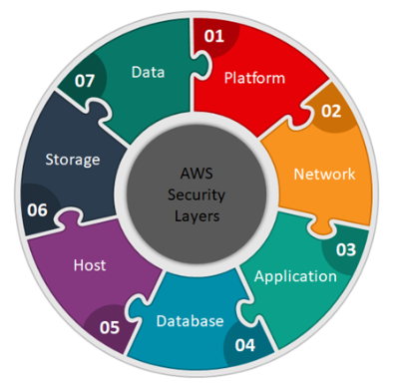
System Architecture
AWS security architecture employs a layered approach, integrating services like IAM for identity and access control, VPC and security groups for network protection, KMS and encryption for data security, CloudTrail and GuardDuty for threat detection and monitoring, and Config and Artifact for compliance and governance. This architecture emphasizes automation and seamless service integration, enabling customers to build and maintain a robust security posture within the AWS cloud, while adhering to the shared responsibility model.

Slide 9
Use Case: 1
Securing a Financial Application (Compliance-Driven): A financial institution deploying a critical banking application on AWS prioritizes regulatory compliance and data protection. They implement stringent IAM controls with MFA and role-based access, isolate the application within a secure VPC, encrypt sensitive data using KMS, and continuously monitor for threats using CloudTrail and GuardDuty. AWS Config ensures ongoing compliance with industry standards like PCI DSS, automating security audits and configuration checks.

Slide 10
Use Case: 2
Protecting a High-Volume E-commerce Platform (Availability and Security): An e-commerce giant handling vast amounts of customer data focuses on both security and platform availability. They utilize AWS WAF and Shield to protect against web exploits and DDoS attacks, ensuring uninterrupted service. Customer data in S3 is encrypted with AES-256, and IAM policies enforce least privilege across all components. Security Hub provides a centralized dashboard for monitoring security posture, and CloudWatch logs enable rapid incident detection and response, crucial for maintaining customer trust.

Slide 11
Challenges and Limitations
AWS security challenges stem from the complexity of the shared responsibility model, the sheer volume of configuration options leading to potential errors, the demanding task of managing encryption keys and ensuring data protection, the burden of adhering to evolving compliance regulations, the need for specialized expertise in threat detection and response, and the ongoing challenge of cost optimization alongside security. Limitations include vendor lock-in due to reliance on AWS-specific tools, complexities in integrating third-party security solutions, restricted visibility into the underlying AWS infrastructure, the constant need to adapt to emerging cyber threats, and the ongoing transition to post-quantum cryptography.

Slide 12

Future Directions
AI-powered automation: For faster threat response.
Zero Trust adoption: For continuous, granular access control.
Post-quantum readiness: To counter future quantum threats.
DevSecOps integration: Building security into development.
Enhanced data privacy: With advanced DLP and governance.
Specialized security: For serverless and edge/IoT environments.

Slide 13

Conclusion
AWS security provides a strong foundation, but requires careful customer configuration due to the shared responsibility model. Challenges exist with complexity, compliance, and expertise. Future directions focus on AI-driven automation, Zero Trust principles, and post-quantum readiness. Enhanced data privacy and specialized security for serverless and edge environments are also key. Successful AWS security relies on a mix of AWS tools and proactive customer implementation of best practices, ensuring continuous vigilance in an evolving threat landscape.

Slide 14
Thank You

